Slide 1


SAP S/4HANA Training
MASTER DATA GOVERNANCE (SAP MDG)
Neeraj Gupta
Session 29
SAP MDG – Home Page, Launchpad Configuration

Slide 2
29
SAP MDG – Home Page, Launchpad Configuration
MDG Homepage
ABAP page builder is used to implement the homepage
Homepage is part of Role definition within transaction PFCG
UI can be adjusted using WebDynpro.

Slide 3
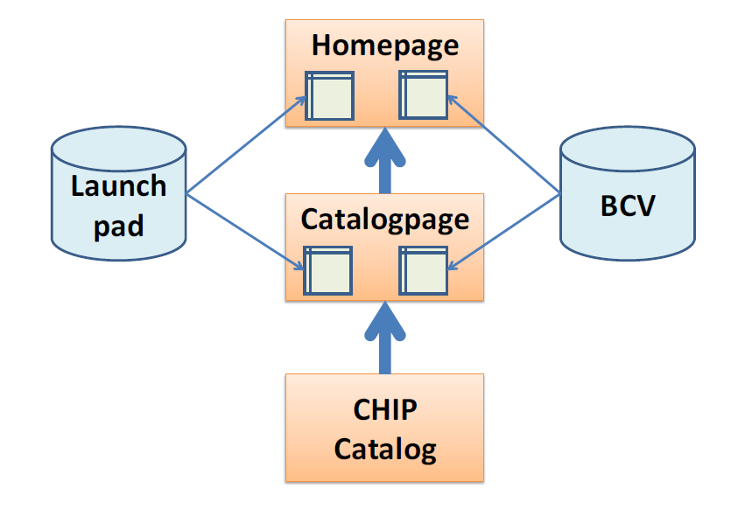
29
SAP MDG – Home Page, Launchpad Configuration
Homepage Customizing
Enables personalization options at administration level for all users of the role
Terms:
Launchpad
Homepage
Catalog Page
Central CHIP Catalog
Concepts:
Customize the catalog page based on the central CHIP catalog
Customize the homepage based on the available CHIPs from the catalog page
Define the available content of the CHIPs using the launchpad

Slide 4
29
SAP MDG – Home Page, Launchpad Configuration
Elements Used to Control the Homepage for the MDG Domain
PFCG Menu Role contains a node “Home“ that links to the WebDynpro Application WDR_CHIP_PAGE with the Application Configuration MDG_BS_MAT_HOME_PFCG_03

Slide 5
29
SAP MDG – Home Page, Launchpad Configuration
Elements Used to Control the Homepage for the MDG Domain
Start the Application Configuration from within PFCG node details
WDR_CHIP_PAGE has a sub-node CHIP_CATALOG that is delivered with the component configuration MDG_BS_MAT_HOME_CATALOG_USAGE_03

Slide 6
29
SAP MDG – Home Page, Launchpad Configuration
Elements Used to Control the Homepage for the MDG Domain
Start the Application Configuration from within PFCG node details
WDR_CHIP_PAGE has a sub-node CHIP_CATALOG that is delivered with the component configuration MDG_BS_MAT_HOME_CATALOG_USAGE_03

Slide 7
29
SAP MDG – Home Page, Launchpad Configuration
Elements Used to Control the Homepage for the MDG Domain
Start the Application Configuration from within PFCG node details
Second link leads to the component configuration specifying the catalog page to use >>
Contains a context-selection-parameter PAGE_CONFIG with the value MDG_BS_MAT_HOME_CATALOG_03

Slide 8
29
SAP MDG – Home Page, Launchpad Configuration
Launchpad
Define Link List >> “Role” and “Instance” contain the name of the Launchpad

Slide 9
29
SAP MDG – Home Page, Launchpad Configuration
Use case: (Transaction LPD_CUST)
Add one special change request type for all users of a role to an existing CHIP as an additional link

Slide 10
29
SAP MDG – Home Page, Launchpad Configuration
Use case: (Transaction LPD_CUST)
Add one special change request type for all users of a role to an existing CHIP as an additional link

Slide 11
29
SAP MDG – Home Page, Launchpad Configuration
Use case: (Transaction LPD_CUST)
Add one special change request type for all users of a role to an existing CHIP as an additional link

Slide 12
29
SAP MDG – Home Page, Launchpad Configuration
Use case: (Transaction LPD_CUST)
Add one special change request type for all users of a role to an existing CHIP as an additional link

Slide 13
29
SAP MDG – Home Page, Launchpad Configuration
Use case: (Transaction LPD_CUST)
Add a new section with new links to launch additional transactions directly from the homepage

Slide 14
29
SAP MDG – Home Page, Launchpad Configuration
Use case: (Transaction LPD_CUST)
Add a new section with new links to launch additional transactions directly from the homepage

Slide 15
29
SAP MDG – Home Page, Launchpad Configuration
Use case: (Transaction LPD_CUST)
Option 1: Enhancement of the Homepage
New CHIP >> add to launchpad

Slide 16
29
SAP MDG – Home Page, Launchpad Configuration
Use case: (Transaction LPD_CUST)
Option 1: Enhancement of the Homepage
New CHIP >> add to launchpad

Slide 17
29
SAP MDG – Home Page, Launchpad Configuration
Use case: (Transaction LPD_CUST)
Option 1: Enhancement of the Homepage
New CHIP >> Add to launchpad

Slide 18
29
SAP MDG – Home Page, Launchpad Configuration
Use case: (Transaction LPD_CUST)
Option 1: Enhancement of the Homepage
New CHIP >> Add to launchpad

Slide 19
29
SAP MDG – Home Page, Launchpad Configuration
Use case: (Transaction LPD_CUST)
Option 1: Enhancement of the Homepage
New CHIP >> Add to launchpad

Slide 20
29
SAP MDG – Home Page, Launchpad Configuration
Use case: (Transaction LPD_CUST)
Option 1: Enhancement of the Homepage
New CHIP >> Add to launchpad

Slide 21
29
SAP MDG – Home Page, Launchpad Configuration
Use case: (Transaction LPD_CUST)
Option 2: Enhancement of the CHIP Catalog and Homepage
New CHIP >> Add to Catalog >> Add to launchpad
Create a favorite

Slide 22
29
SAP MDG – Home Page, Launchpad Configuration
Use case: (Transaction LPD_CUST)
Option 2: Enhancement of the CHIP Catalog and Homepage
New CHIP >> Add to Catalog >> Add to launchpad
Access using SE80

Slide 23
29
SAP MDG – Home Page, Launchpad Configuration
Use case: (Transaction LPD_CUST)
Option 2: Enhancement of the CHIP Catalog and Homepage
New CHIP >> Add to Catalog >> Add to launchpad
Customizing for Home page catalog

Slide 24
29
SAP MDG – Home Page, Launchpad Configuration
Use case: (Transaction LPD_CUST)
Option 2: Enhancement of the CHIP Catalog and Homepage
New CHIP >> Add to Catalog >> Add to launchpad
Customizing for Home page catalog

Slide 25
29
SAP MDG – Home Page, Launchpad Configuration
Use case: (Transaction LPD_CUST)
Option 2: Enhancement of the CHIP Catalog and Homepage
New CHIP >> Add to Catalog >> Add to launchpad
Customizing for Home page catalog >> Define Link List, add parameters, change Title

Slide 26
29
SAP MDG – Home Page, Launchpad Configuration
Use case: (Transaction LPD_CUST)
Option 2: Enhancement of the CHIP Catalog and Homepage
New CHIP >> Add to Catalog >> Add to launchpad
Customizing for Home page >> NWBC / PFCG > Start customizing

Slide 27
29
SAP MDG – Home Page, Launchpad Configuration
Use case: (Transaction LPD_CUST)
Option 2: Enhancement of the CHIP Catalog and Homepage
New CHIP >> Add to Catalog >> Add to launchpad
Customizing for Home page >> CHIP Catalog for a list of the available CHIPs based on the definition of the catalog page (MDG_BS_MAT_HOME_CATALOG_03)

Slide 28
29
SAP MDG – Home Page, Launchpad Configuration
Use case: (Transaction LPD_CUST)
Additional Content using CHIPs using PFCG Link List
>> Directly reflects the definition of a folder of the PFCG role. The “PFCG Link List” is assigned with the PFCG Alias to a folder of a PFCG role

Slide 29
29
SAP MDG – Home Page, Launchpad Configuration
Use case: (Transaction LPD_CUST)
Additional Content using CHIPs using PFCG Link List
>> PFCG role contains the tag in the attribute ‘Application Alias’. Homepage and the referenced PFCG folder is part of the same PFCG role

Slide 30
29
SAP MDG – Home Page, Launchpad Configuration
Use case: (Transaction LPD_CUST)
Use case: Add Analytic Reports >> Additional graphical reports to include on homepage

Slide 31
29
SAP MDG – Home Page, Launchpad Configuration
Use case: (Transaction LPD_CUST)
Use case: Create New Roles for Menus with New Homepages
Option 1: For smaller differences in the menus, you can use the “PFCG Link List” CHIP instead of the “Launchpad Link List” CHIP.
Option 2: For larger differences, create a homepage for each PFCG role
Steps:
1. To create a new homepage, copy the delivered one.
2. Start transaction SE80 >> Web Dynpro Configuration WDR_CHIP_PAGE >> Component configuration MDG_BS_MAT_HOME_PFCG_03 (or MDG_BS_MAT_HOME_CATALOG_03 >> Copy the catalog

Slide 32

End of Session 29

Slide 33

Questions

Slide 34

Neeraj Gupta

Slide 35


We’re committed to empower you to be
Most Desirable Resource
through powerful training solutions.
We build the workforce of the future.
250+
Corporate Clients
30,000+
Learners Trained
25000+
Learners Placed
FREE WEBINARS
Sign up for free webinars with industry experts every fortnight!
Enroll Now!
Contact us today!
https://anubhavtrainings.com/

Slide 36




More from AnubhavTrainings.com

